Slide 1
SchedulEd
CS 691 Asynchronous
Capstone
Team 1
Professor Henry Wong
Spring 2025

Slide 2

Agenda T
Team Member Roles and Responsibilities
Improvements
Project Description
Team Working Agreement
Schedule
Personas
MVP
Technologies/API
Algorithms
Sprint 1 and 2 Summary
Product Backlog/Sprint 3 Test cases/Sprint 3 Stories
Sprint 3 Completed/Not Completed
Metrics/Team Velocity
Burndown Charts
Retrospective
Project Demo and APIs
Group Wiki Page

Slide 3
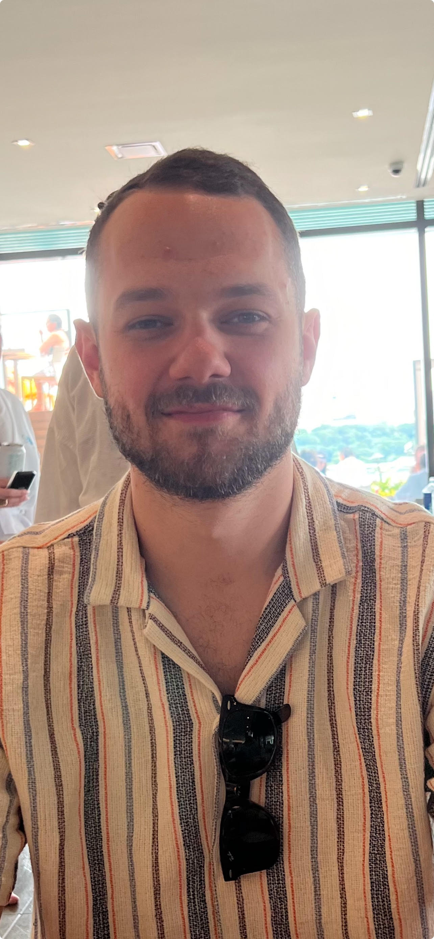
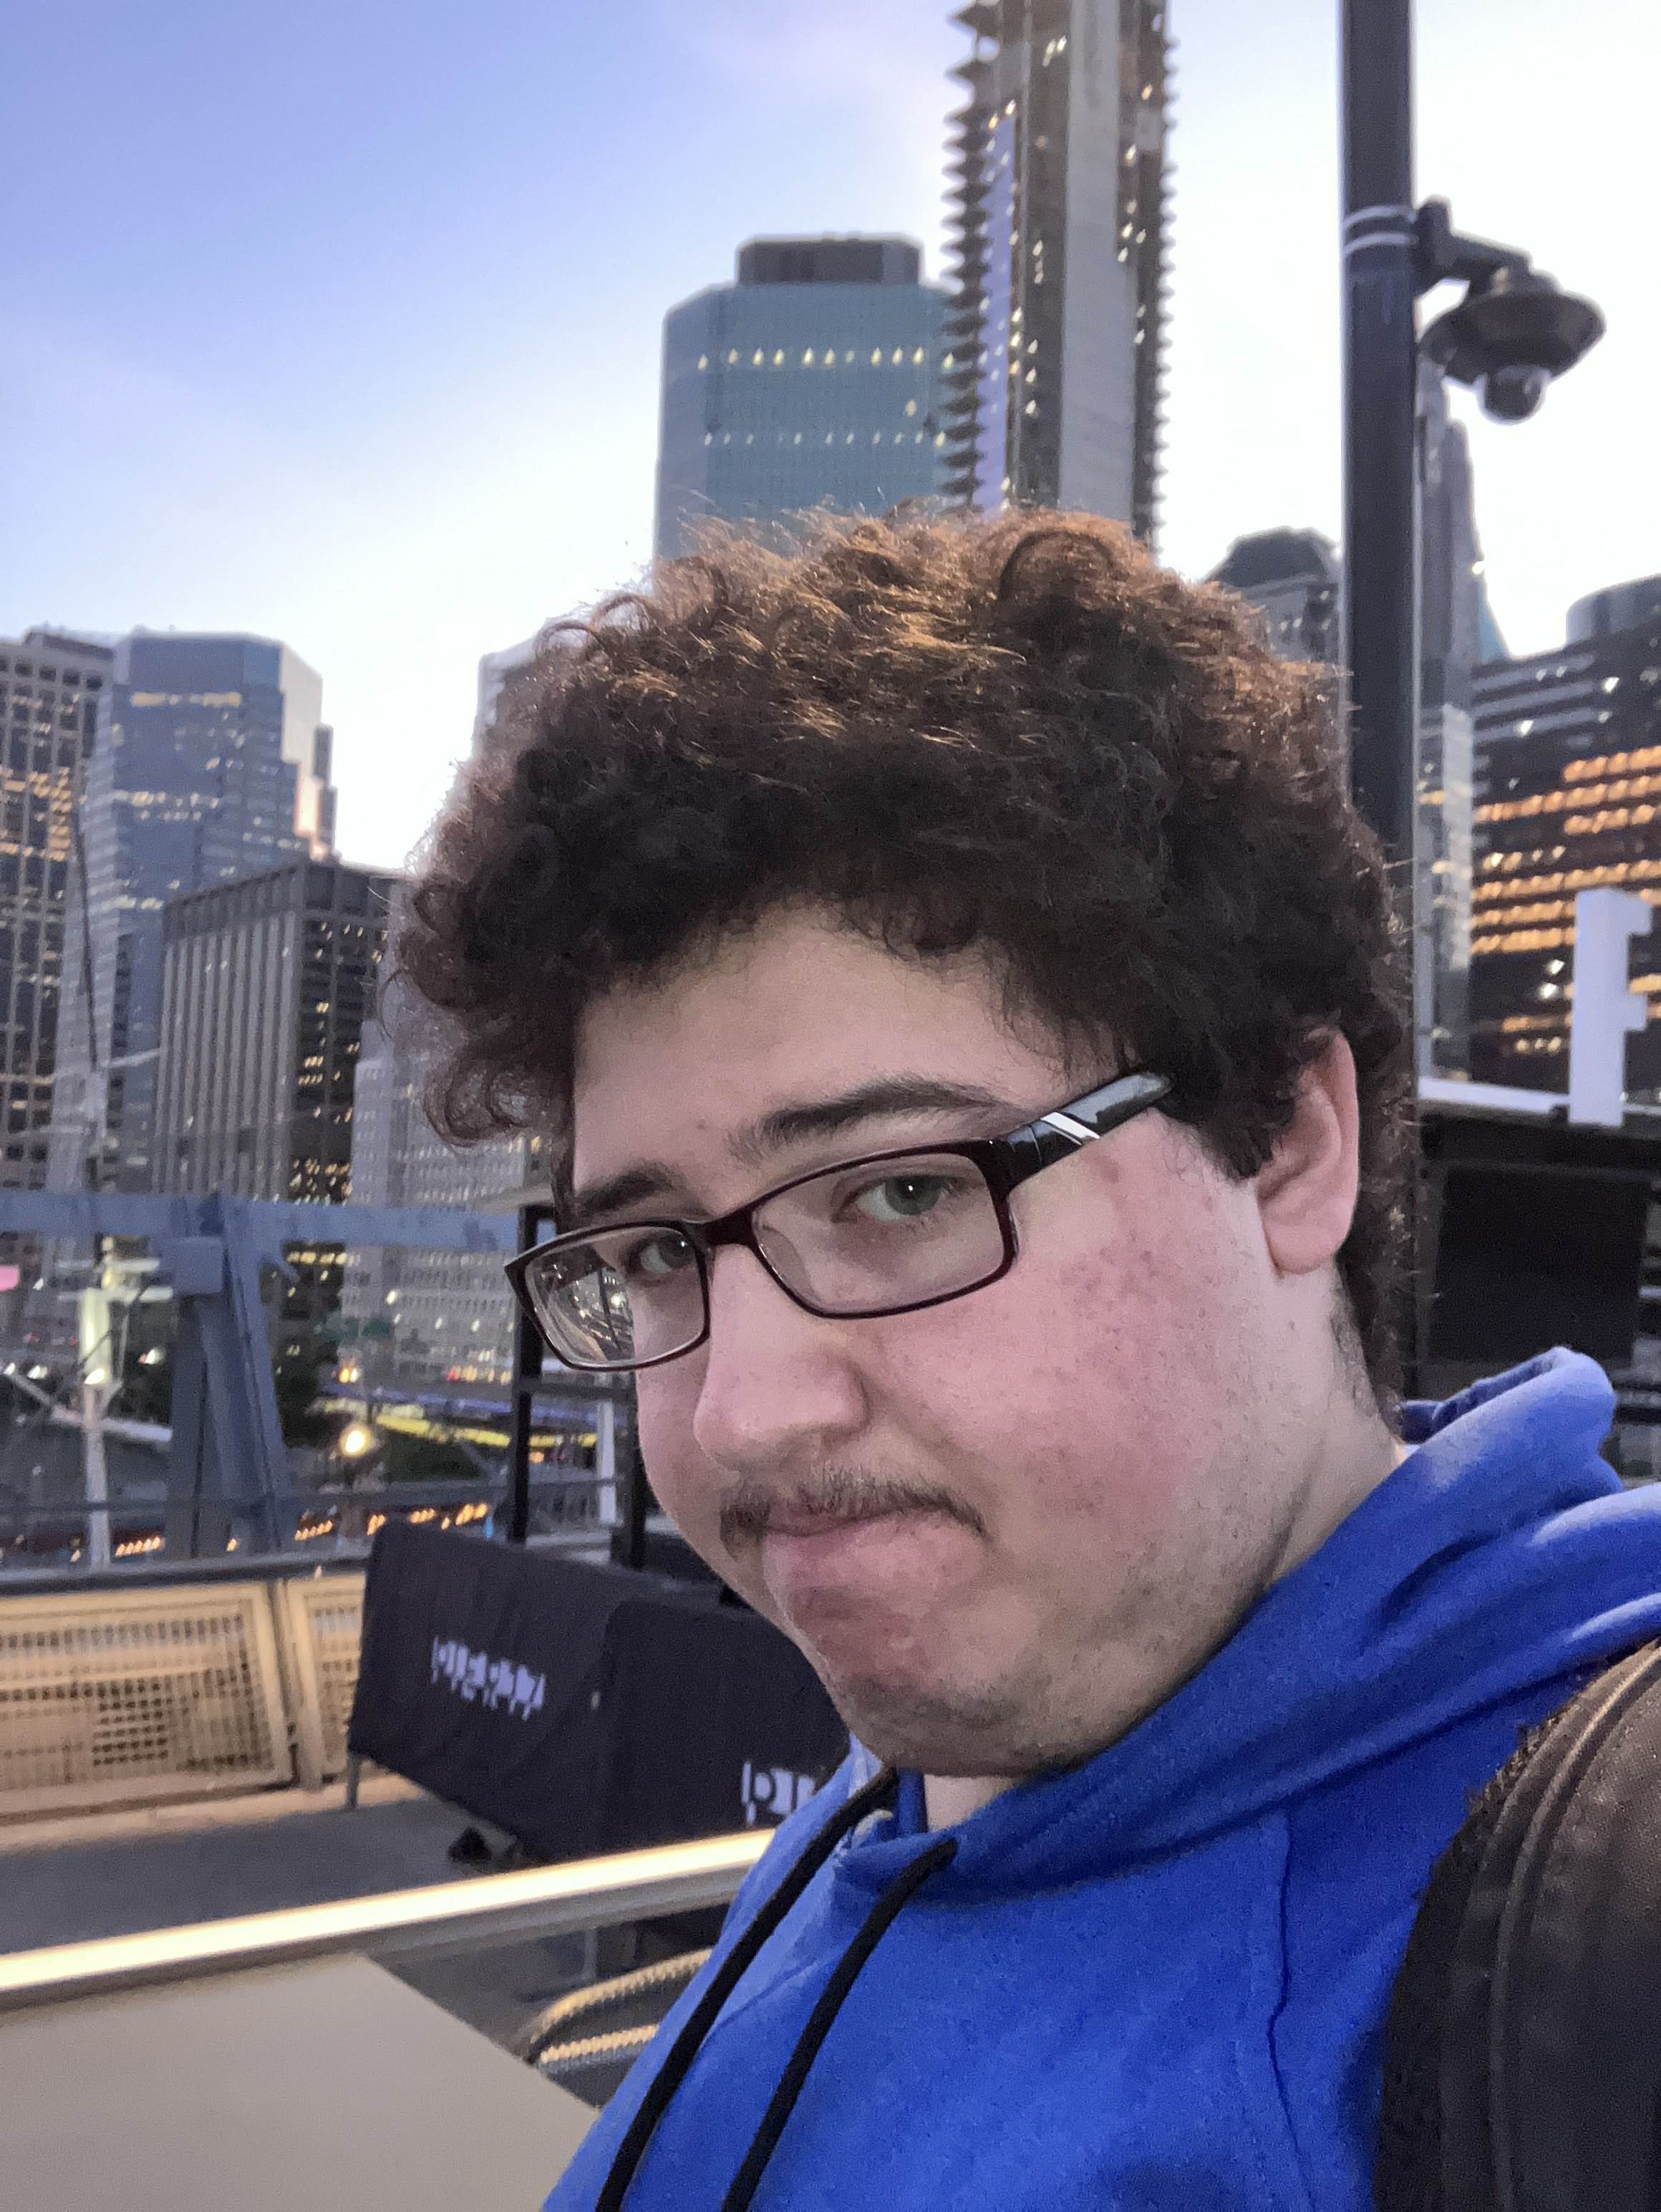
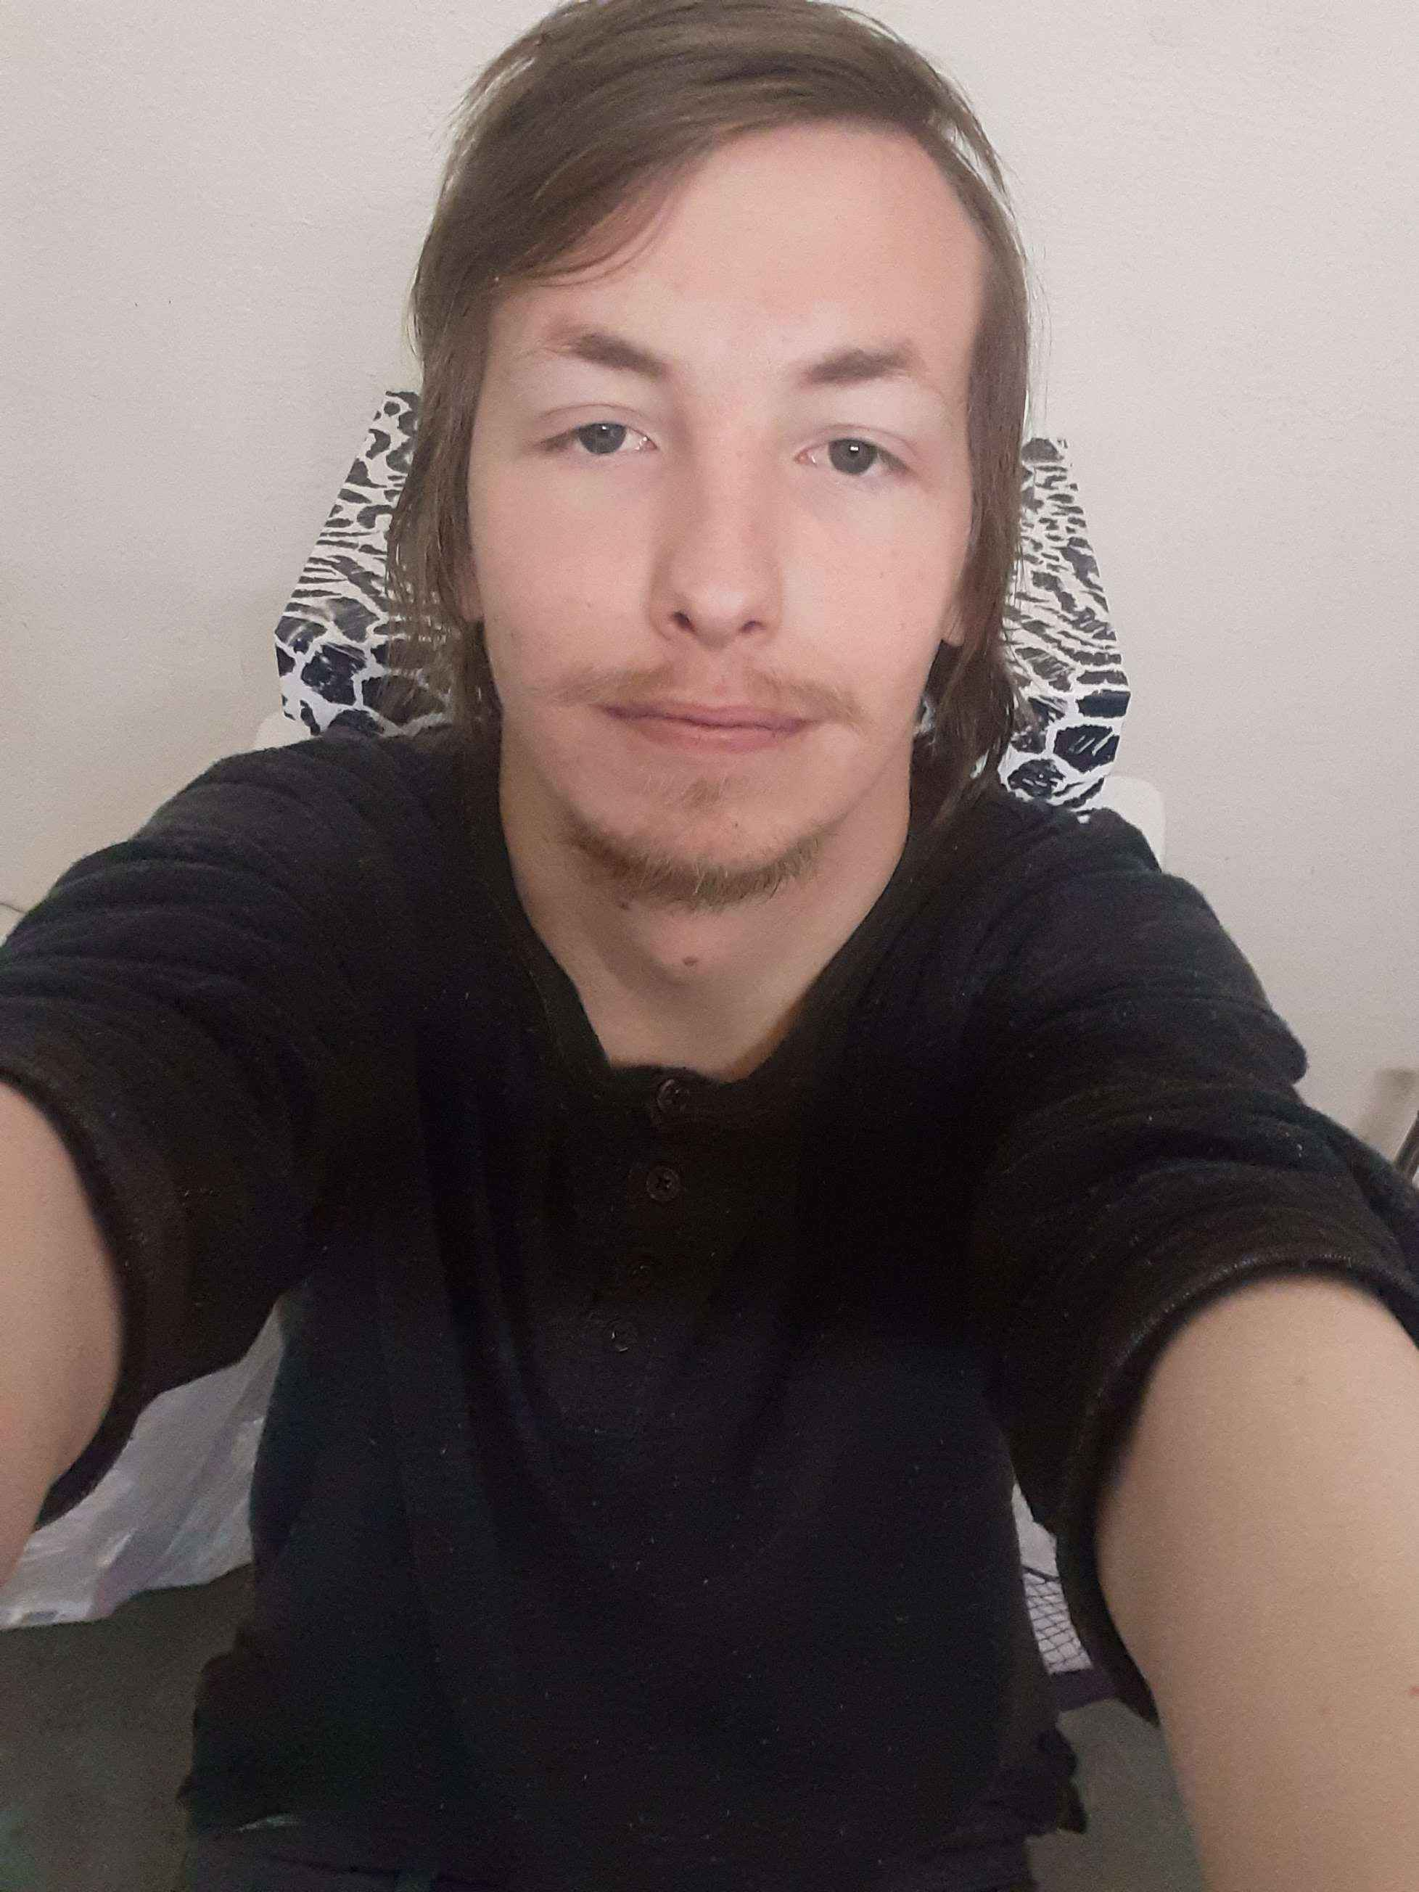
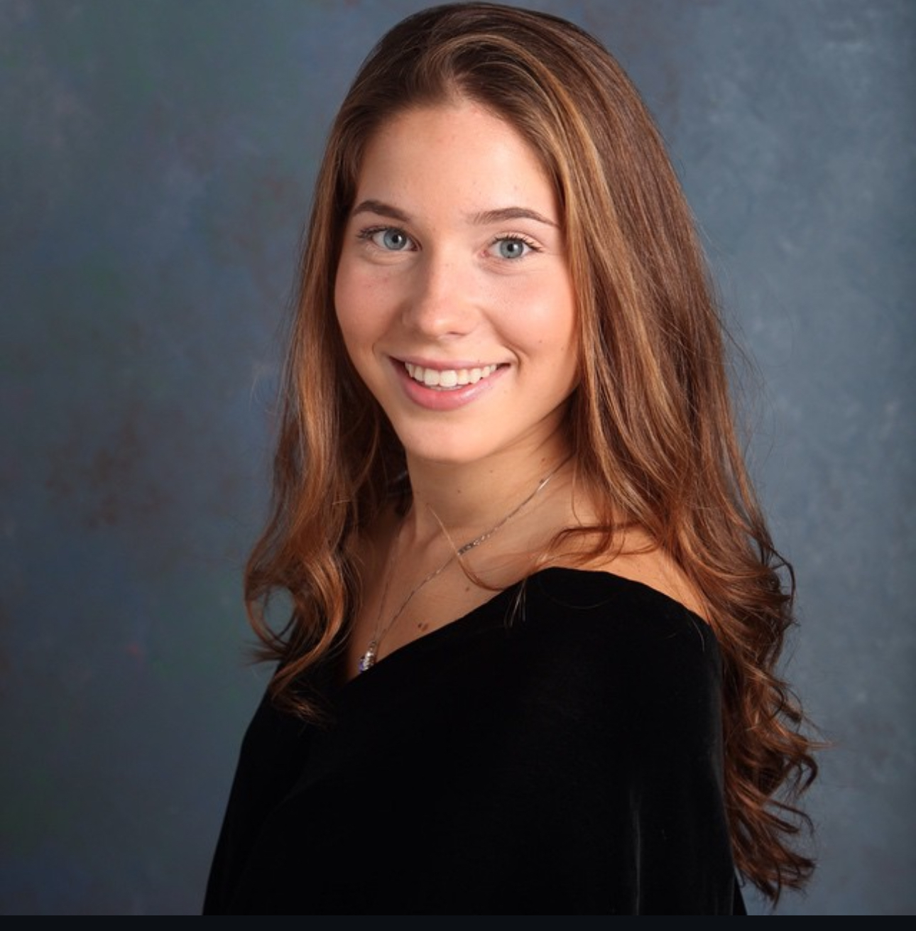
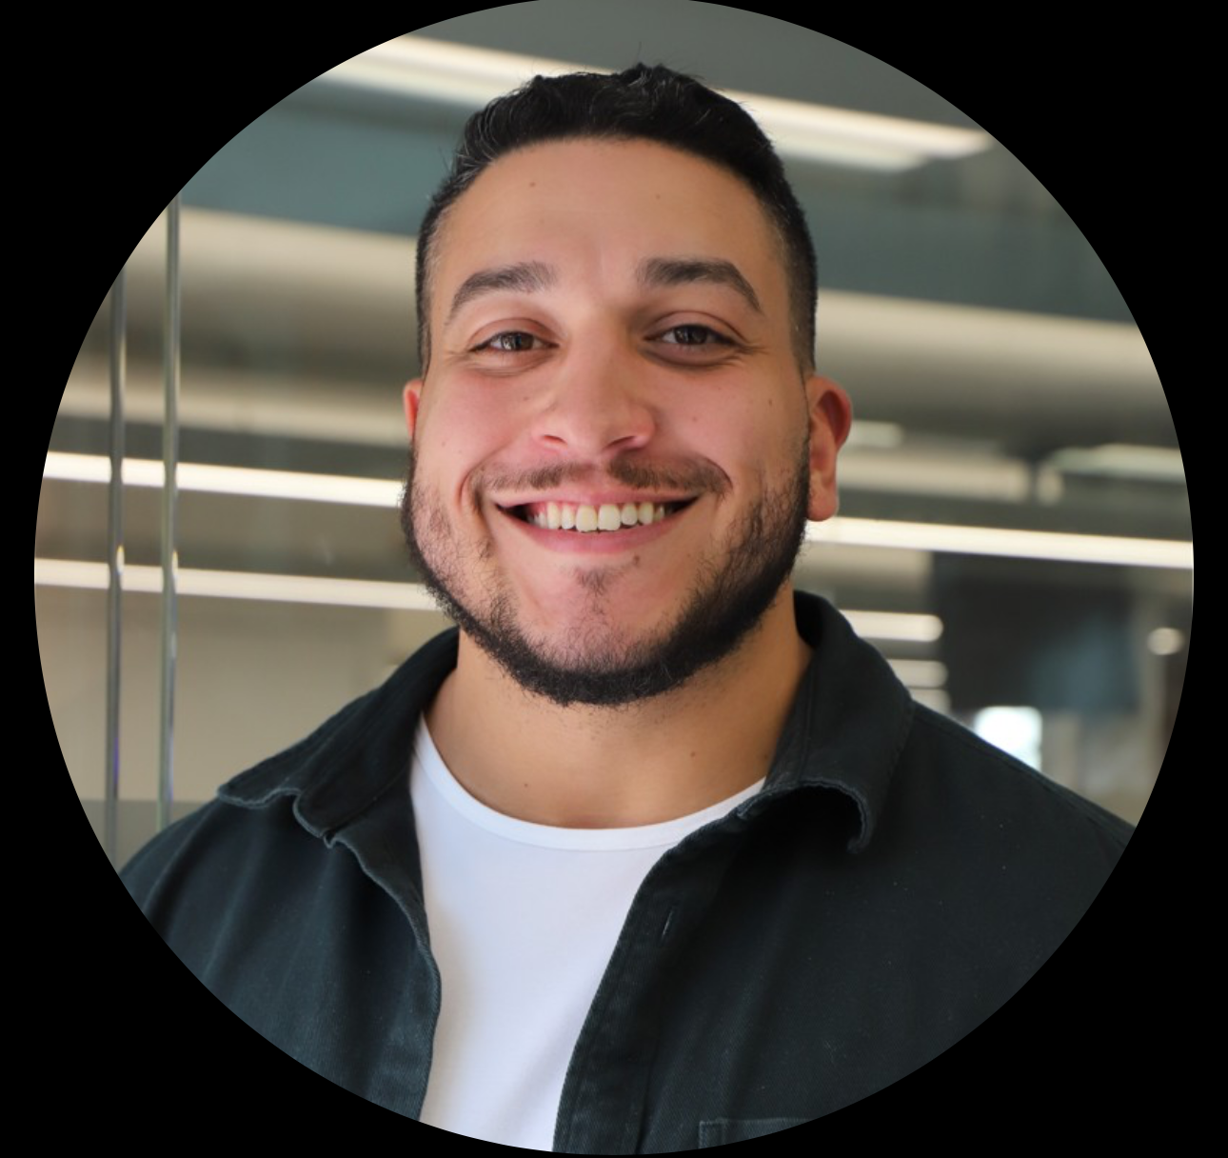
Team Members T
Sabrina Scaccio: Scrum Master / Developer
Thomas D'Anna: Front End Developer
Justin Rivera:
Front End Developer
Victor Zapata III:
Back End Developer
Michael Silva:
Back End Developer

Slide 4
Improvements J
The user stories were not written in the right format. We still had Given-then-when as user stories. Given-Then-When is a format for writing acceptance criteria not user stories.
Story Points need to be in Fibonacci numbers. We had estimation points that are not in Fibonacci numbers.
Missing Recap slides for Sprint 1.
When presenting the burndown, we need to tell the story of how the team progressed or fell behind the schedule.
API/Code slides - need to present any API and elaborate on the code.

Slide 5

Project Description J
ScheduleEd is a scheduling app that will assist teachers, parents, and students with the process of booking, managing, and tracking tutoring sessions. This app will focus on alleviating scheduling conflicts among all involved. Often, students have various commitments after school that are hard for the parents to manage. The times of these various extracurricular activities change. This has a trickledown effect on the teachers. This app will allow parents to book with a more flexible approach. They can go week by week, selecting times that work for them and their child. This app will eliminate scheduling conflicts, reduce ineffective communication, and avoid double-bookings and no-shows. In just the tap of a button, parents and students will be able to book, cancel, and reschedule appointments! The app will remind students/parents of their sessions and will allow the tutor to have a better scope at their week. It also will allow the tutor to notify parents of available times, rather than going back and forth, guessing what time will work. This app will aid many teachers, private tutors, and tutoring centers with a way to manage their learning schedule in a much more organized fashion.

Slide 6
Team Working Agreement J
Team communication will occur using Microsoft Teams/I-Message
Open communication with each other when problems do arise, ecspecially with our code.
Meetings will be held using Microsoft Teams. We will meet weekly on Wednesdays/Sundays @8:00 pm. We will add meetings as needed, to stay on top of deadlines. Meetings will be about a half hour.
At the beginning of each sprint, we will hold a sprint planning meeting, in which everyone is given their tasks.
Before the sprint is over, we will hold a meeting on our retrospectives.
Each team member will understand their role and what they are responsible for.

Slide 7
Team Working Agreement CONT. J
Everyone will adhere to the due dates and the due date of when we want tasks done, will be discussed at the meeting.
Each team member has their own task but is reminded that we are a team, and things may not go as smoothly for others.
When there are conflicts within your own task, it is required that you tell the team immediately so that they can assist you and there are no delays in due dates.
Each team member is asked to come to the meetings fully prepared with their task.
We will continue to learn through this project and produce new innovative ways to tackle this capstone project.
Final work should be submitted as follows:
The team has reviewed your work
There are no errors within your code
All tasks were tested
Work meets the criteria of the class
Code is uploaded to Github
All aspects of the sprint are complete

Slide 8
Project Schedule V
 | Start | End
Sprint 0 | January 21st | February 10th
Sprint 1 | February 11th | March 10th
Sprint 2 | March 11th | April 7th
Sprint 3 | April 8th | May 5th

Slide 9

Persona 1 S
Kathy is a private tutor working both online and in-person. While she enjoys teaching, managing her growing client base has become increasingly difficult. She often struggles with overbooking and scheduling conflicts, as manually tracking appointments leads to occasional double bookings or missed sessions. With an automated scheduling system, students could book sessions based on her availability, preventing conflicts and last-minute mix-ups. A student profile feature would help her store session notes and track progress efficiently, ensuring personalized lesson plans for each student.
Kathy - Wants a comprehensive tutor scheduling planner for managing multiple clients.

Slide 10

Persona 2 S
Jake is a 16-year-old high school student juggling multiple tutoring sessions alongside his regular schoolwork and extracurricular activities. He often forgets about scheduled lessons or struggles to find time for rescheduling when conflicts arise. He has a hard time keeping track of assignments and notes from his tutoring sessions, often misplacing important study materials. With automated reminders, he would never miss an appointment, reducing last-minute cancellations and lost study time. A built-in calendar would help him visualize his schedule, ensuring he doesn’t double-book tutoring with other commitments. A session tracking feature would allow him to store lesson notes, assignments, and key takeaways in one place, making it easier to review material when studying.
Jake – Looking for centralized app for managing tutoring sessions and study material

Slide 11

Persona 3 S
Debra is a busy mother of 3, trying to balance her work schedule while ensuring her 10-year-old daughter stays on top of her tutoring sessions. Debra often finds it challenging to keep track of lesson times, and her daughter's overall progress. In the chaotic life of a parent of multiple children, tutoring schedules sometimes slip through the cracks, leading to missed or forgotten sessions. She also struggles to stay updated on what Emily is working on in her sessions, relying on scattered notes from tutors or brief updates from her daughter. A session log feature would provide insight into Emily’s progress, giving Debra access to lesson notes and assignments so she can stay informed and involved in her child’s learning. A tutor scheduling app would be a game-changer for Debra, allowing her to keep all of Emily’s tutoring information in one place.
Debra - Keeping track of child's appointments and progress.

Slide 12
MVP V
Accounts/Firebase Integration (User Profile and Registration)
Tag based Search System (Subject and Time Preference)
Schedule/Book Sessions
Google Integration

Slide 13




Technology M
Frontend
Backend

Slide 14
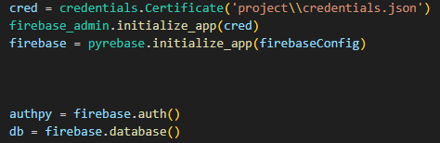
Firebase Realtime database api V
Used to store user information.
Names
IDS
Role
Subjects
Used to store schedule information
Start and End Time
People involved

Slide 15
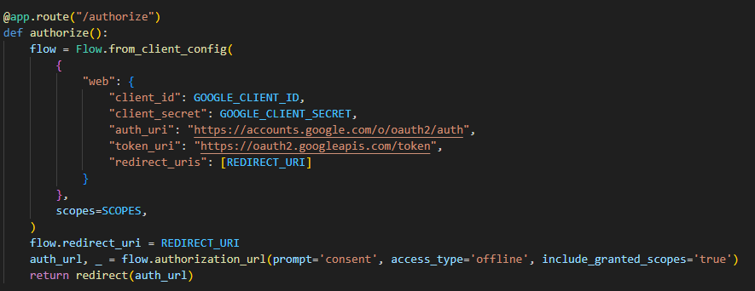
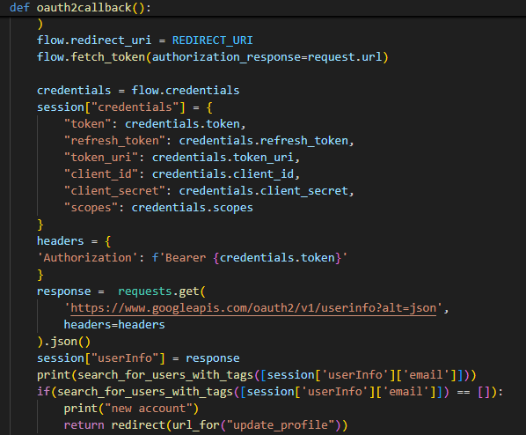
GOOGLE CALENDAR API M

Slide 16
Algorithm V
Content-Based Filtering
Based on Tags, the code searches for users that meet those requirements.
Goes through the entire user's section in the database, searching for user accounts that have those tags and returns a list of those users.

Slide 17

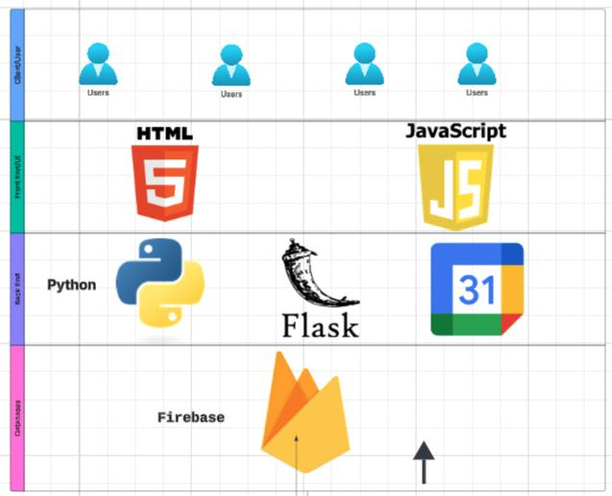
Architecture Diagram

Slide 18
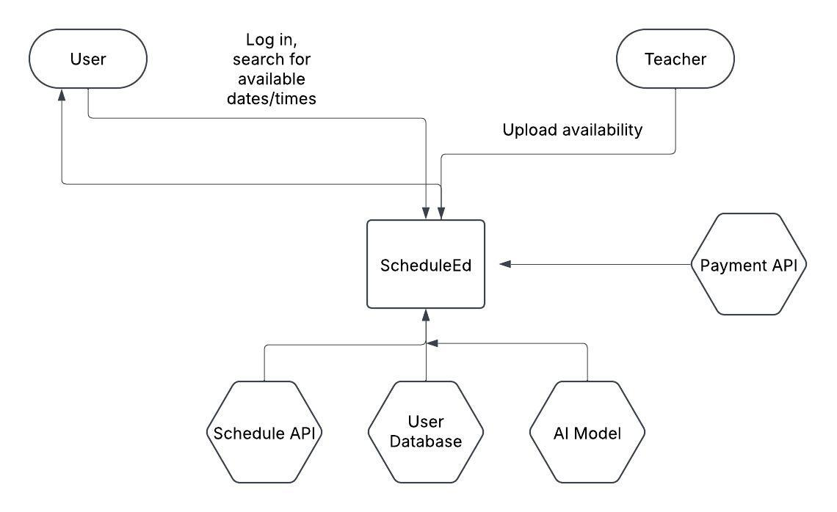
Context Diagram

Slide 19
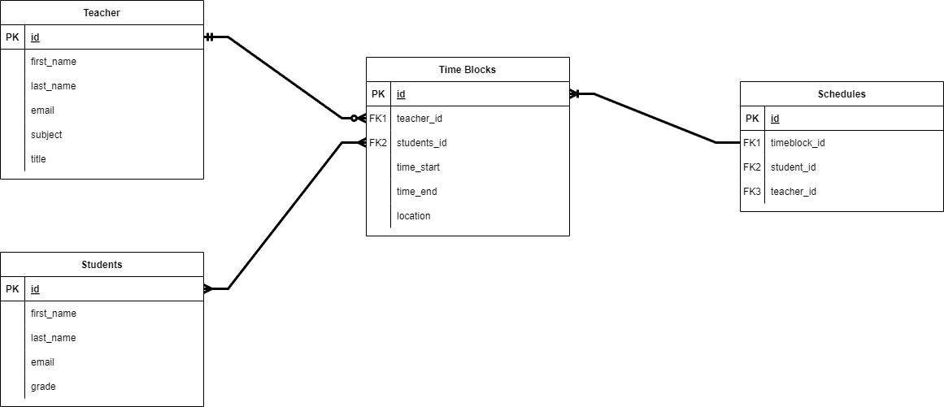
ER Diagram

Slide 20
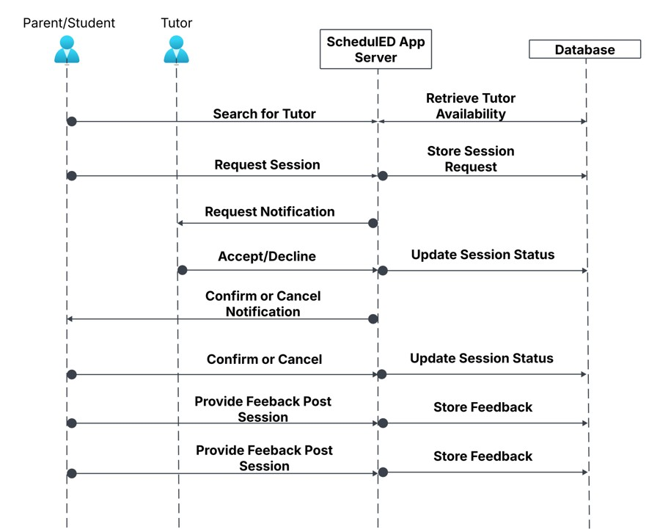
Sequence Diagram

Slide 21
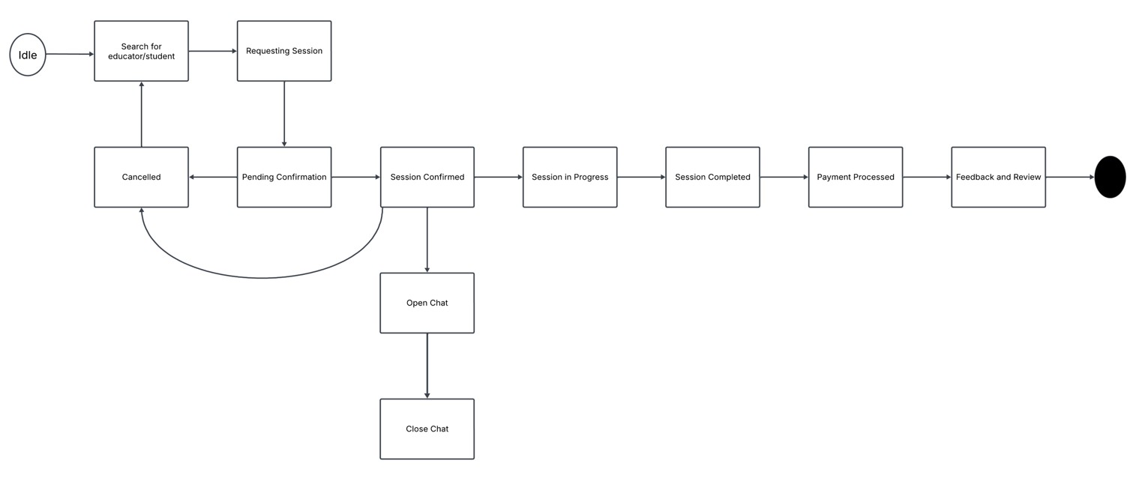
State Diagram

Slide 22
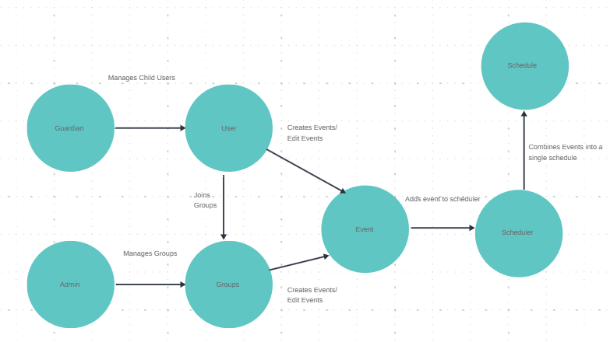
Concept Diagram

Slide 23
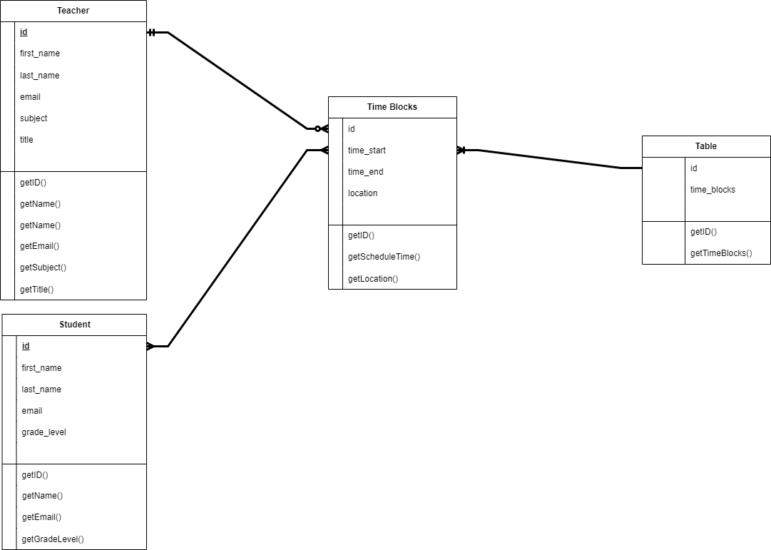
Class Diagram

Slide 24
Sprint 1 Recap S
Developed all our needed diagrams
Created our product backlog
Decided on what technologies to use to develop the code
Decided on what algorithms to use
Account Creation

Slide 25
Sprint 2 Recap S
User Login
Created a Home Screen
Firebase API was implemented
User Selection Role

Slide 26
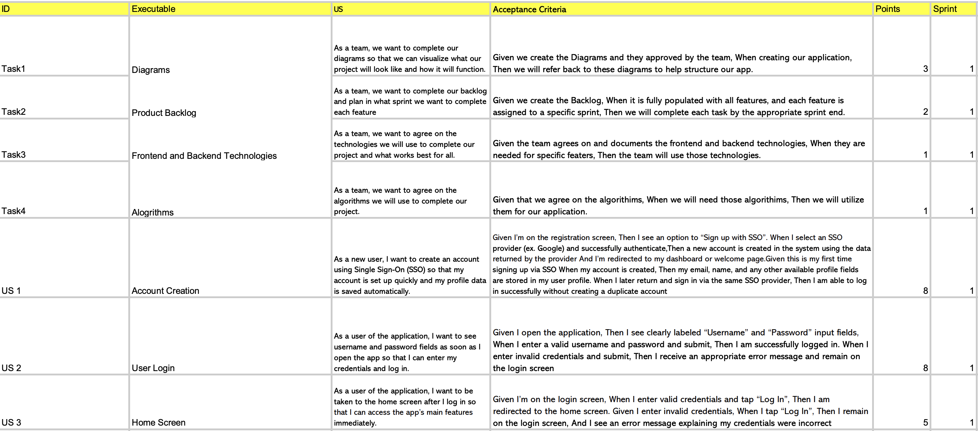
Product Backlog T

Slide 27
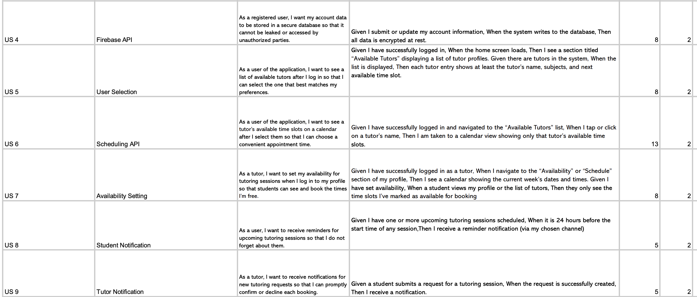
Product Backlog T

Slide 28
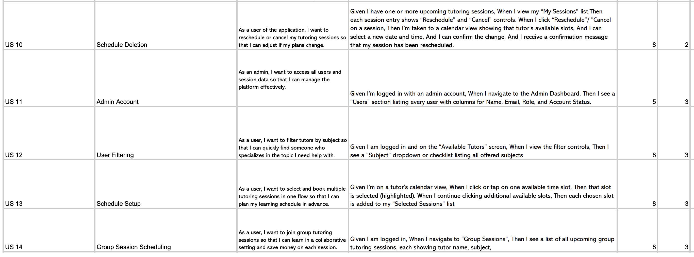

Product Backlog T

Slide 29
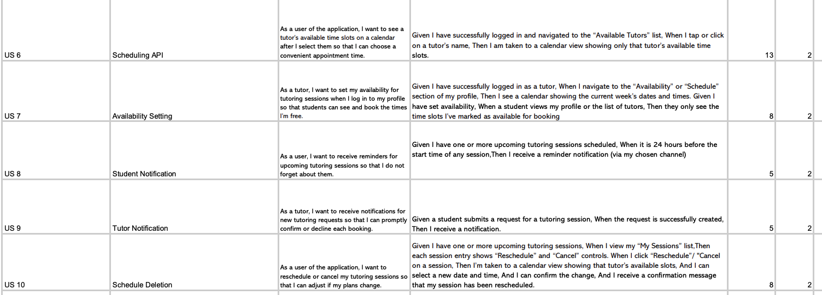
Sprint 3 User Stories and Rollover From Sprint 2 stories S

Slide 30
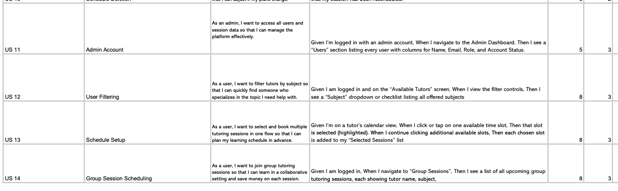
Sprint 3 User Stories and Rollover From Sprint 2 stories S

Slide 31
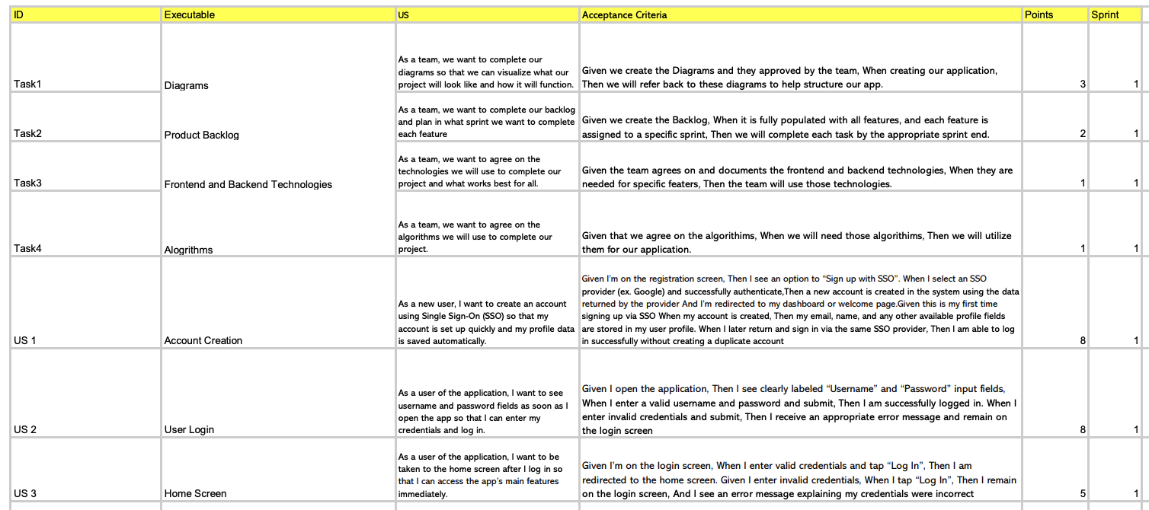
Sprint 1 Summary T

Slide 32
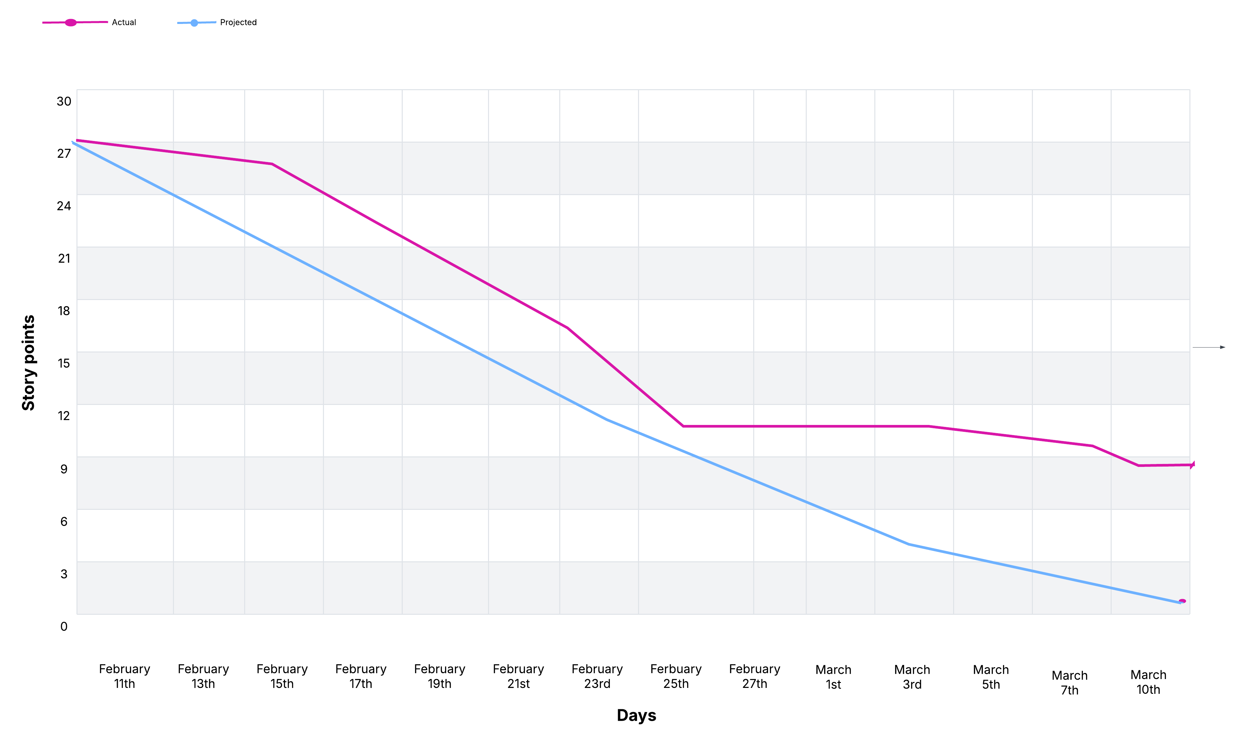
Sprint 1 Burn down Chart T

Slide 33
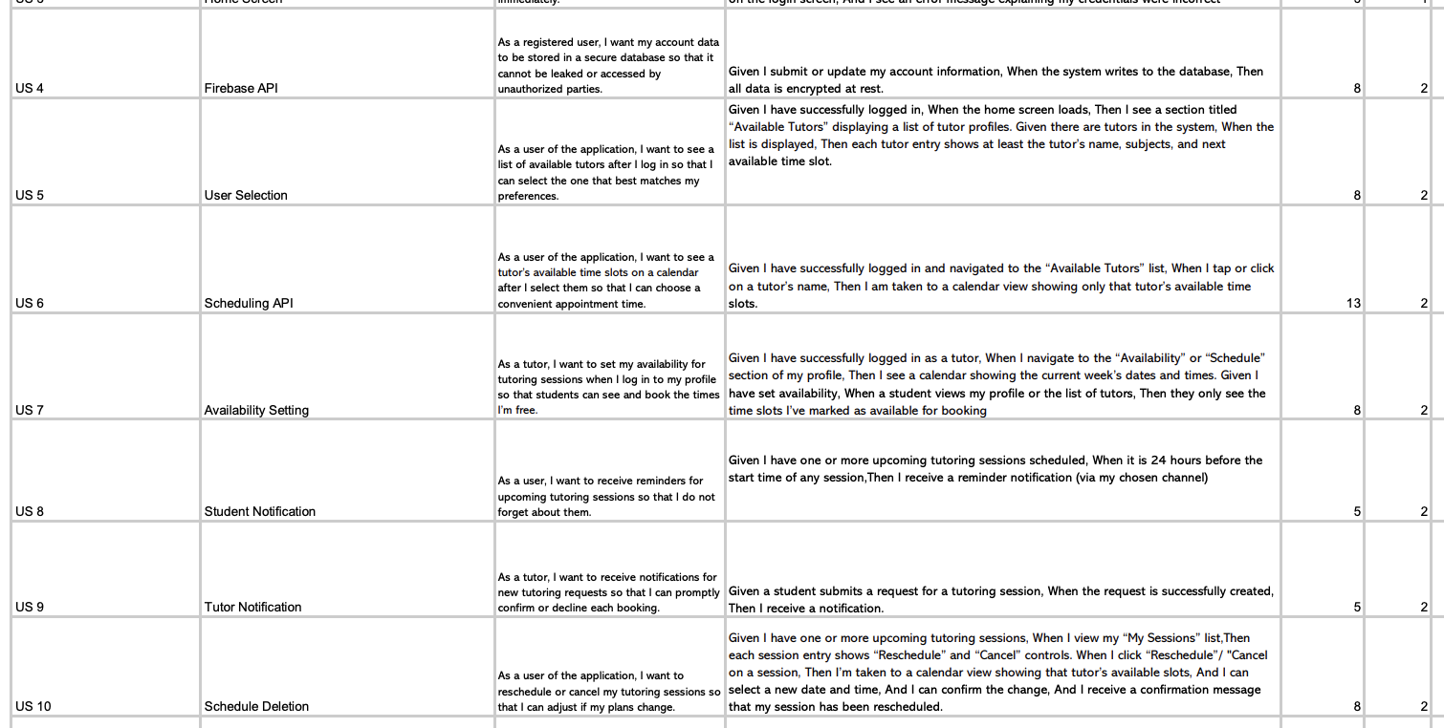
Sprint 2 Summary J

Slide 34
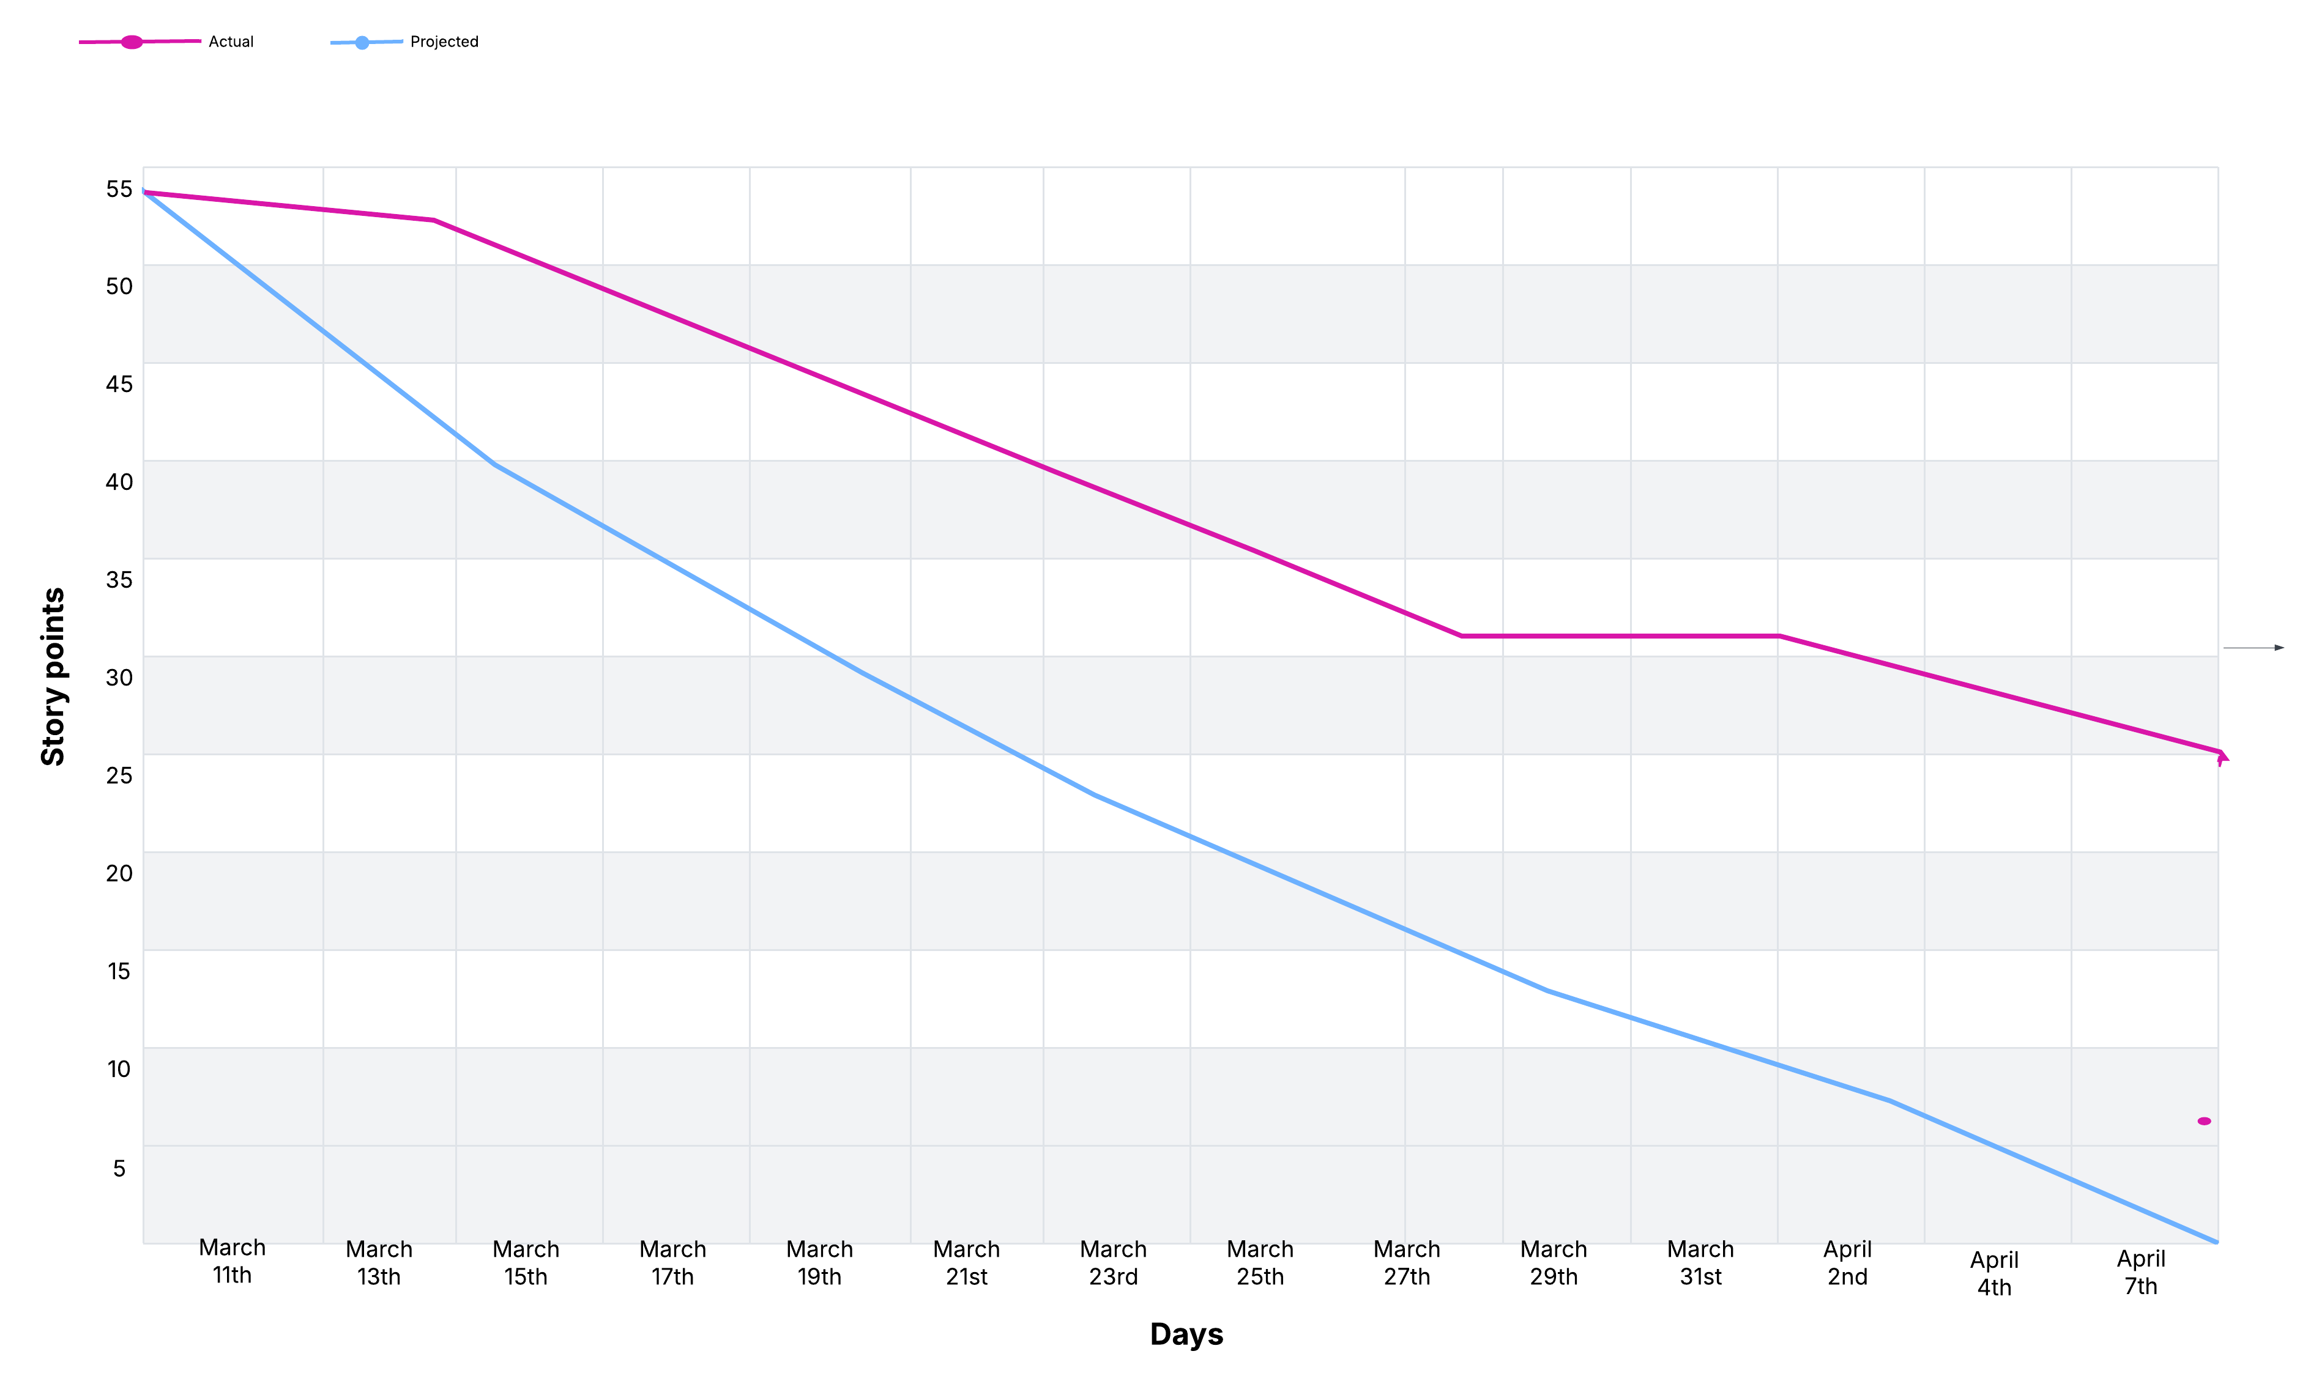
Sprint 2 Burn down chart J

Slide 35
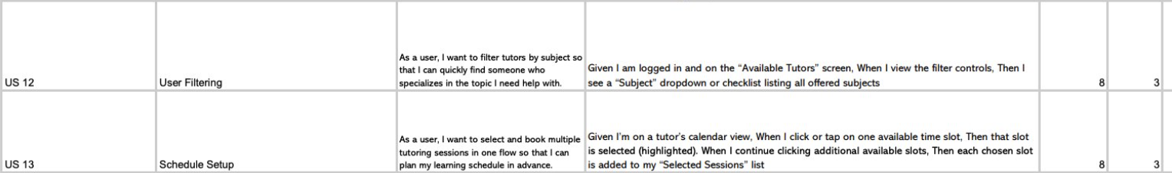
Sprint 3 Stories completed V

Slide 36
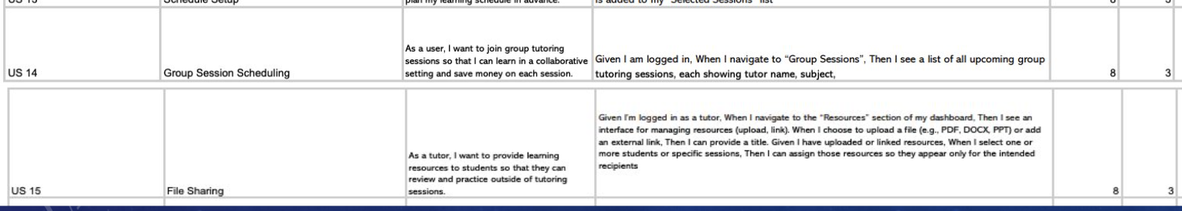
Sprint 3 Stories Not Completed V

Slide 37
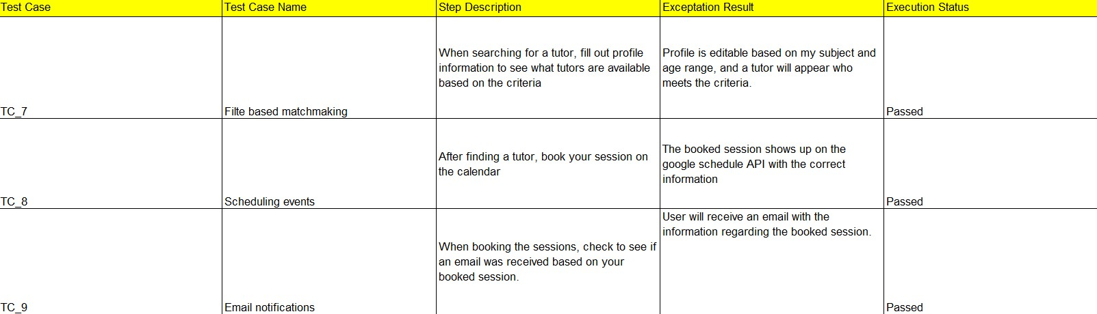
Sprint 3 Test Cases V

Slide 38
Sprint 3 Velocity S
Total Story Points: 76 Velocity: 51 Story Points Completed

Slide 39
Metrics Committed/Completed Ratio S
51 Story points completed of out 76 story points committed = 67% Completed

Slide 40
Historical and Average Committed Ratio M

Slide 41
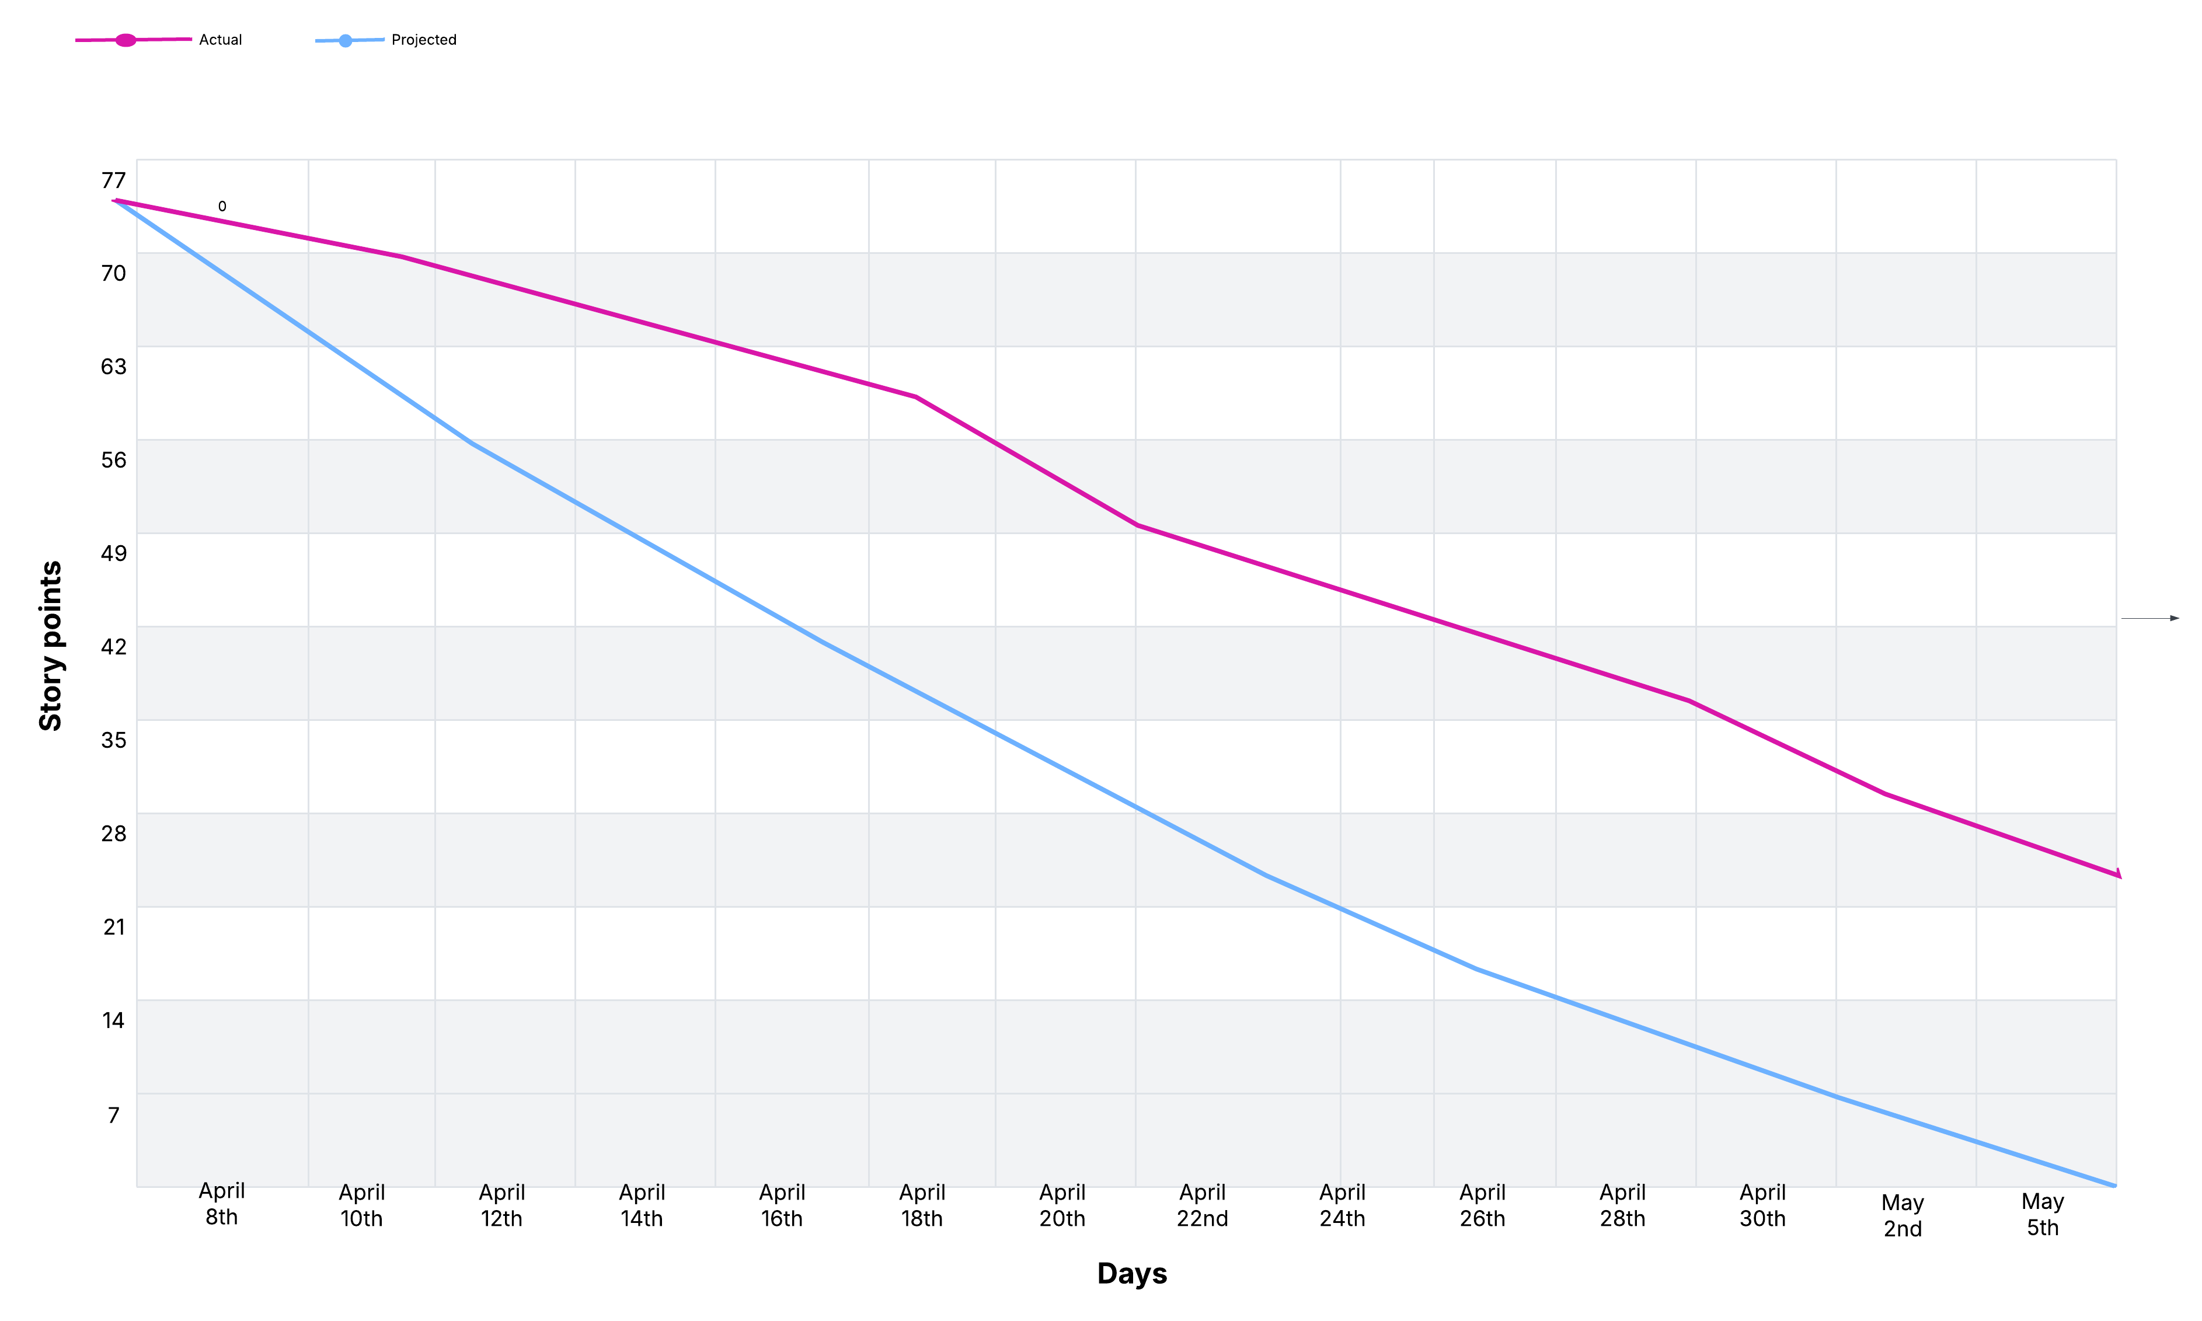
Burndown Chart Sprint 3 M

Slide 42
Historical Velocity/Average Velocity S
Sprint 1 Velocity: 20/28 Sprint 2 Velocity: 30/55 (Includes Prior Story that was not completed in sprint 1) Sprint 3 Velocity: 51/76(Includes Prior Story Points that were not completed in sprint 2) Average Velocity: (20+30+51)/3 = 33.6666 points per sprint

Slide 43
Retrospective S
The Good
Everyone did a better job with their own individual tasks.
Everyone was open to changing things if challenges interfered.
We had more meetings where we did more collaborative work.
Communication improved with more updates in the chat.
Made a lot of progress, given the little amount of time.
The Bad
Some features took longer than anticipated to complete.
Some Features were more challenging than we initially thought. ​
Due to work/grad schoolwork, meeting time could get a bit challenging.
Time management, as always, we thought we had more time than we initially thought. The semester flew by.
Final Thoughts for improvements
Meet as many times as possible because much more is accomplished when we work as a team.
Always have a backup plan and be willing to adjust your original plan.
Reach out to the professor more with questions when problems arise.
Always keep the communication flowing.
Be realistic with our expectations.

Slide 44
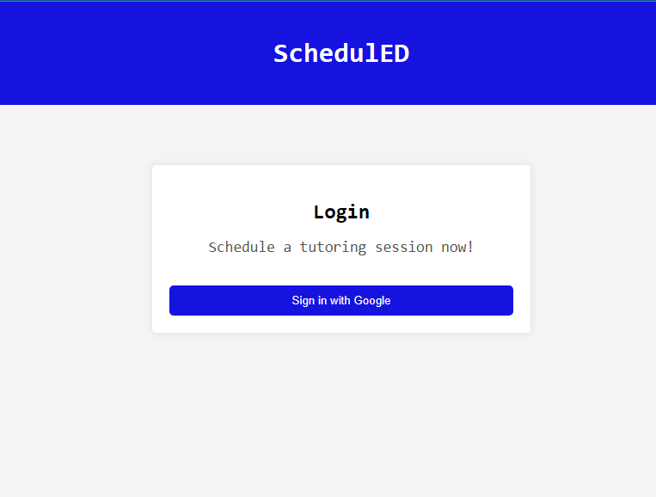
Project Demo V

Slide 45
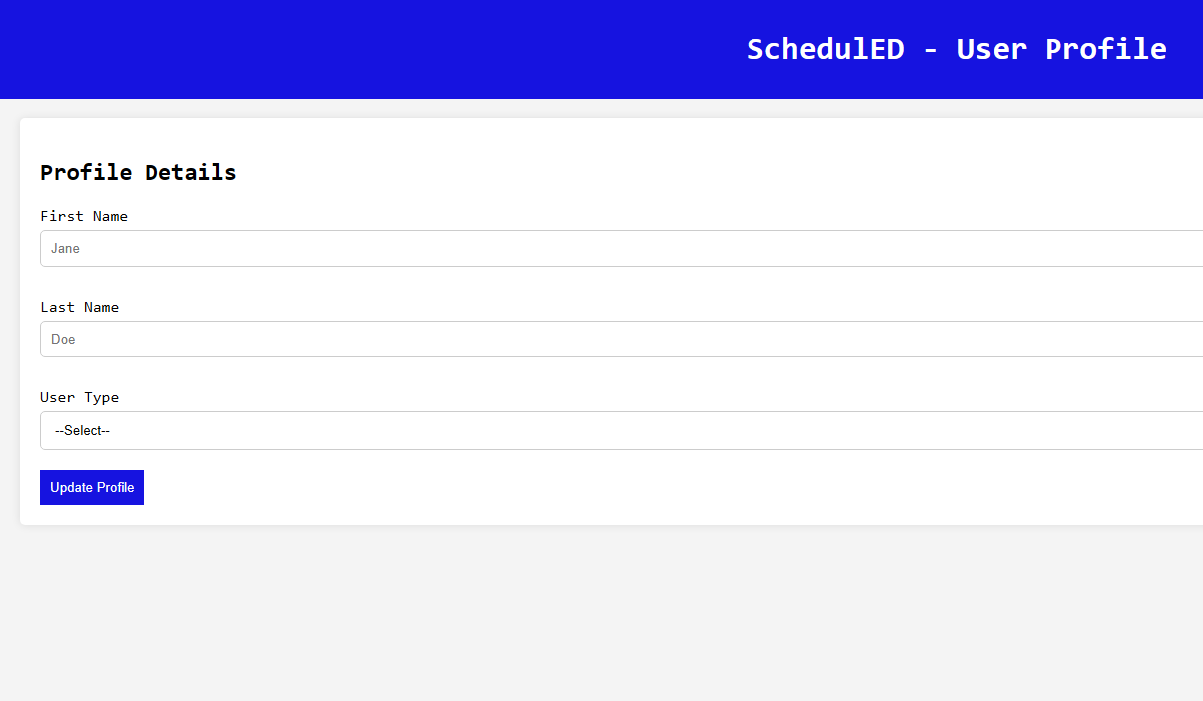
Project Demo

Slide 46
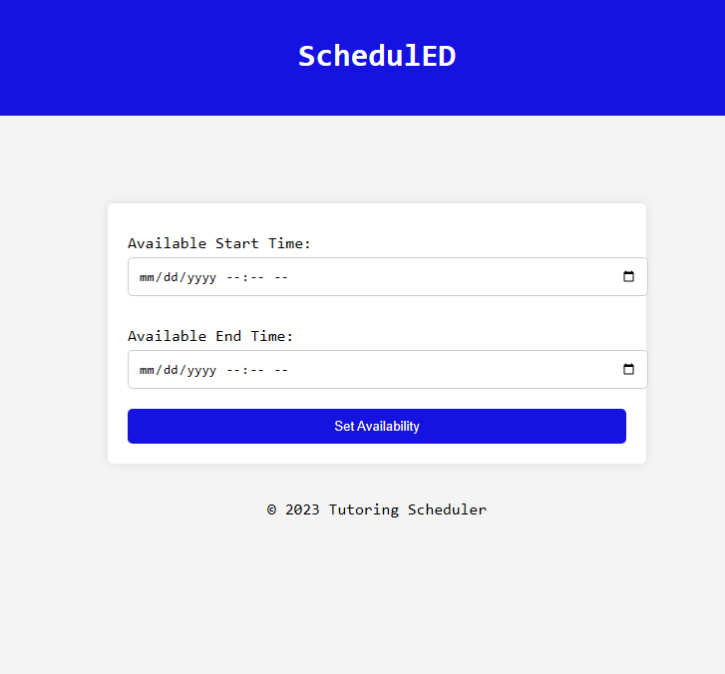
Project Demo

Slide 47
Group Wiki Link
https://github.com/htmw/2025SA-Team1/wiki

